Slide 1
Neither Hype nor Horror
Creating a people centered IoT Architecture for the Smart City
Kip Harkness, Deputy City Manager
kip.harkness@sanjoseca.gov
@kipthinks

Slide 2
San José

Slide 3
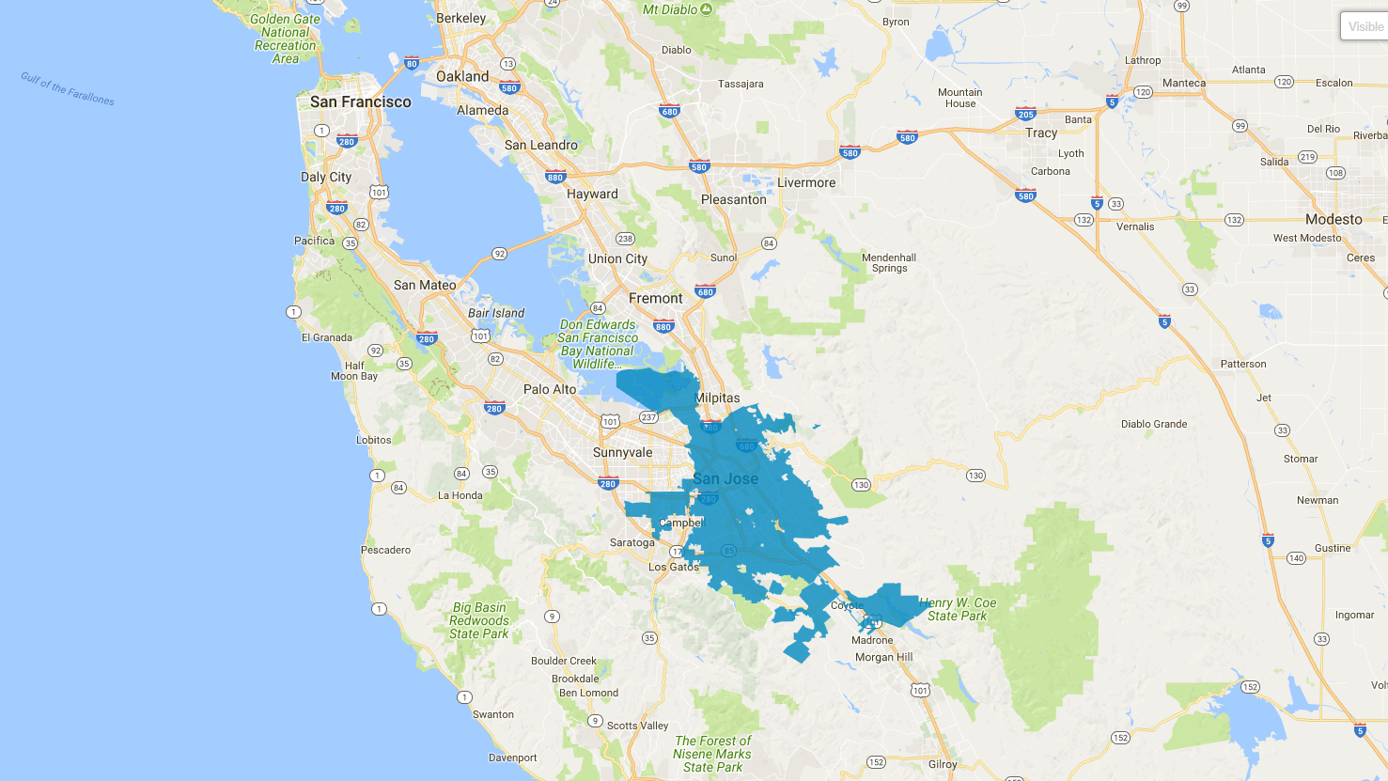
San José
180
square miles
Founded 1777
1,027,000
people
Notes:
CA’s first civilian settlement, and first city to incorporate in 1850.
Over 2x the size of oakland (78 sq. mi)
Over 3x the size of SF (49 sq.mi)

Slide 4
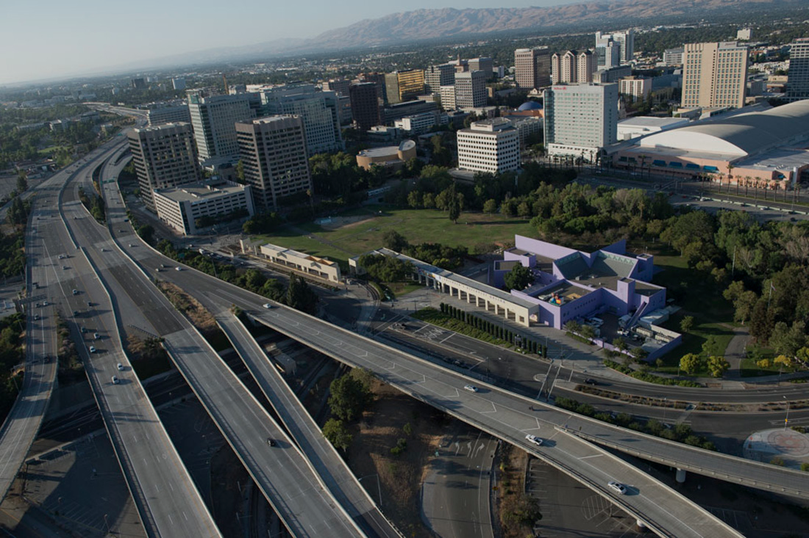
San José
35%
asian
32%
latino
26%
white
6%
black , other
41%
Have a bachelor’s degree
57%
Speak a language other than English at home
28%
of households earn less than $50k
16%
of households earn above $200k
39%
Born outside the United States

Slide 5
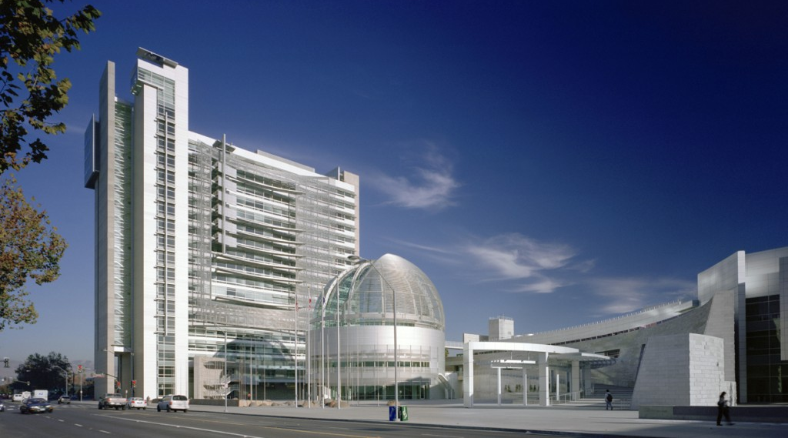
San José city government
6,000 employees
11.2 million airport passengers per year
1.8 million library books
565,000 police emergency calls per year
3,500 acres of parkland
2,400 miles of streets
2,300 fires per year
2,030 municipal sewer mains
178 zoo animals

Slide 6
Why does innovation matter?
Notes:
“Why are we here?” Activity Discussion
Goal: Ground the event in participants’ own motivations and interests in innovation.
Supplies: 2 wireless mics, pens, post-it notes
Instructions for the group:
Why does innovation matter? “Think about the last 12 months in the City of San Jose, come up with one example of EITHER something really innovative that it inspired you, or something so painful that you wanted to change it immediately. We’ll give you a few minutes to reflect and think of a one story. (2 minutes)
“Now, turn to your neighbor and exchange stories.” (4 minutes each, 8 minutes total)
“Who heard a story that they’d like to share with the group?” (Share stories from a few people – 8 minutes)

Slide 7
2015 Imperative to Innovate | Strategy None | Traditional Government Customer Experience | Paper and In-Person Often Frustrating
 |  | Inefficient Process | Often Not Documented Sometimes Nonexistent Frequently Inconsistent
 |  | Outdated Technology | Decade of Disinvestment Archaic Legacy Systems Security Risk Closed Systems
 |  | Exhausted People | Demotivated by Cuts and Struggle
Notes:
Microsoft 2003

Slide 8
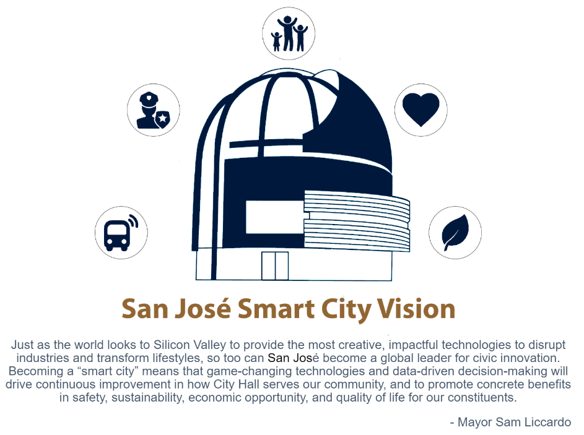
User-Friendly City
Inclusive
City
Safe City
Demonstration City
Sustainable City
Notes:
User-Friendly City - Create digital platforms to improve transparency, empower residents to actively engage in the governance of their city, and make the City more responsive to the complex and growing demands of our community.
Safe City - Leverage technology to make San José the safest big city in America. Includes building safety (code enforcement), transportation (E.g. traffic accidents), crime and policing.
Inclusive City - Ensure all residents, businesses, and organizations can participate in and benefit from the prosperity and culture of innovation in Silicon Valley. E.g. digital infrastructure, access to economic opportunity
Demonstration City - Reimagine the City as a laboratory and platform for the most impactful, transformative technologies that will shape how we live and work in the future.
Sustainable City - Utilize technology to address energy, water, and climate challenges to enable sustainable growth.
Surfing the wave analogy.

Slide 9
WHAT should we focus on?
Notes:
“Why are we here?” Activity Discussion
Goal: Ground the event in participants’ own motivations and interests in innovation.
Supplies: 2 wireless mics, pens, post-it notes
Instructions for the group:
Why does innovation matter? “Think about the last 12 months in the City of San Jose, come up with one example of EITHER something really innovative that it inspired you, or something so painful that you wanted to change it immediately. We’ll give you a few minutes to reflect and think of a one story. (2 minutes)
“Now, turn to your neighbor and exchange stories.” (4 minutes each, 8 minutes total)
“Who heard a story that they’d like to share with the group?” (Share stories from a few people – 8 minutes)

Slide 10
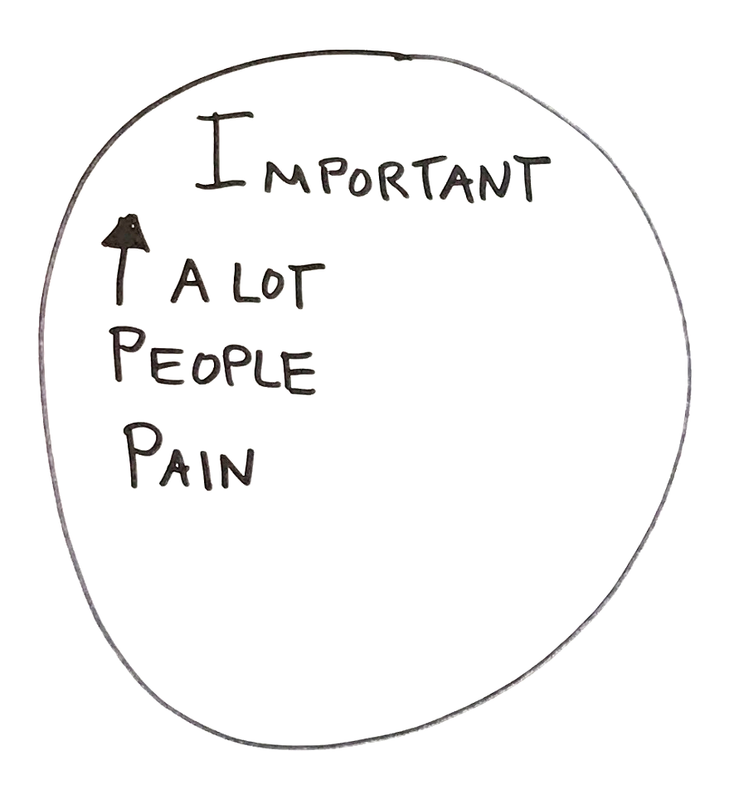
What we work on

Slide 11
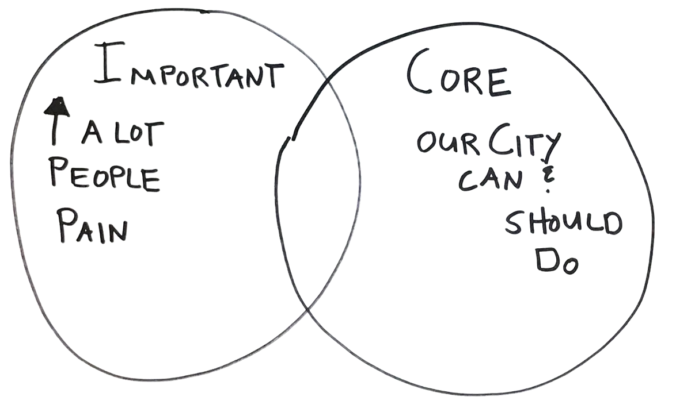
What we work on

Slide 12
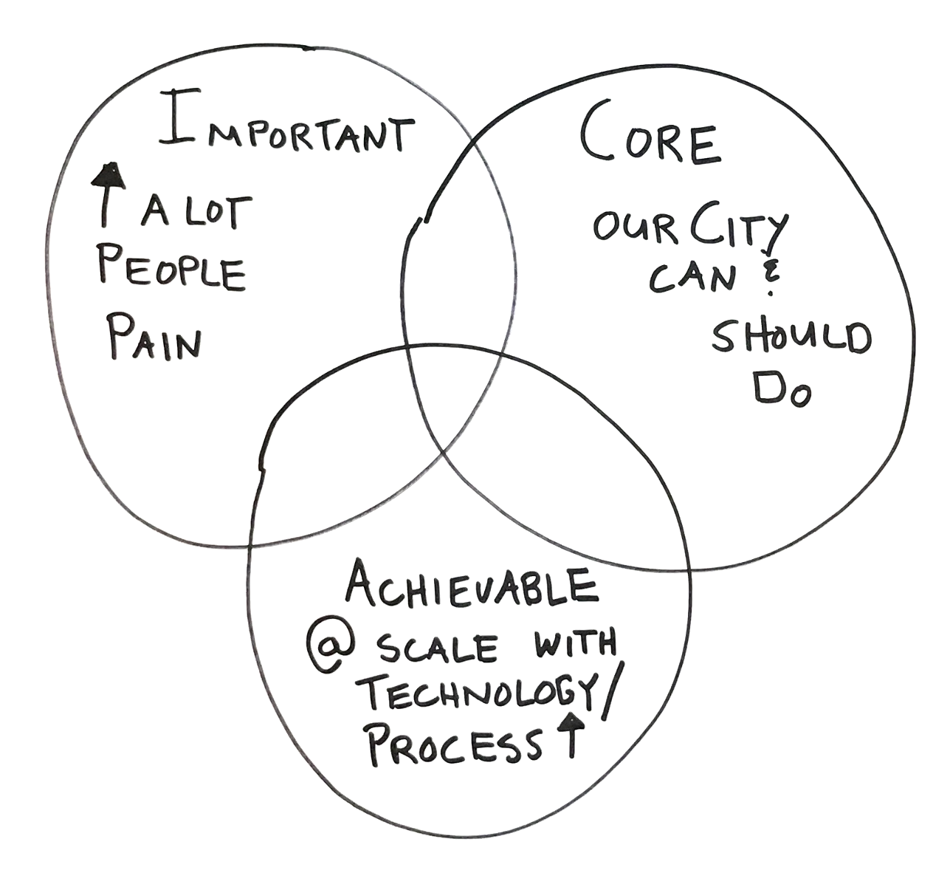
What we work on

Slide 13
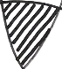
What we work on
Notes:
Provide specific “sweet spot” examples.
1. Development Services: Upgrading the existing development services permitting system and implementing process improvements.
2. CRM: ​An end-to-end digital customer relationship management (CRM) solution that includes a customer-facing mobile app, cross-department service request handling, and consolidated analytics.
3. Master addressing database. An accurate, complete, reliable, centrally-managed, and geographically-enabled for emergency dispatch, noticing, permitting, billing, and GIS analysis.

Slide 14

Risk
Effort

Slide 15
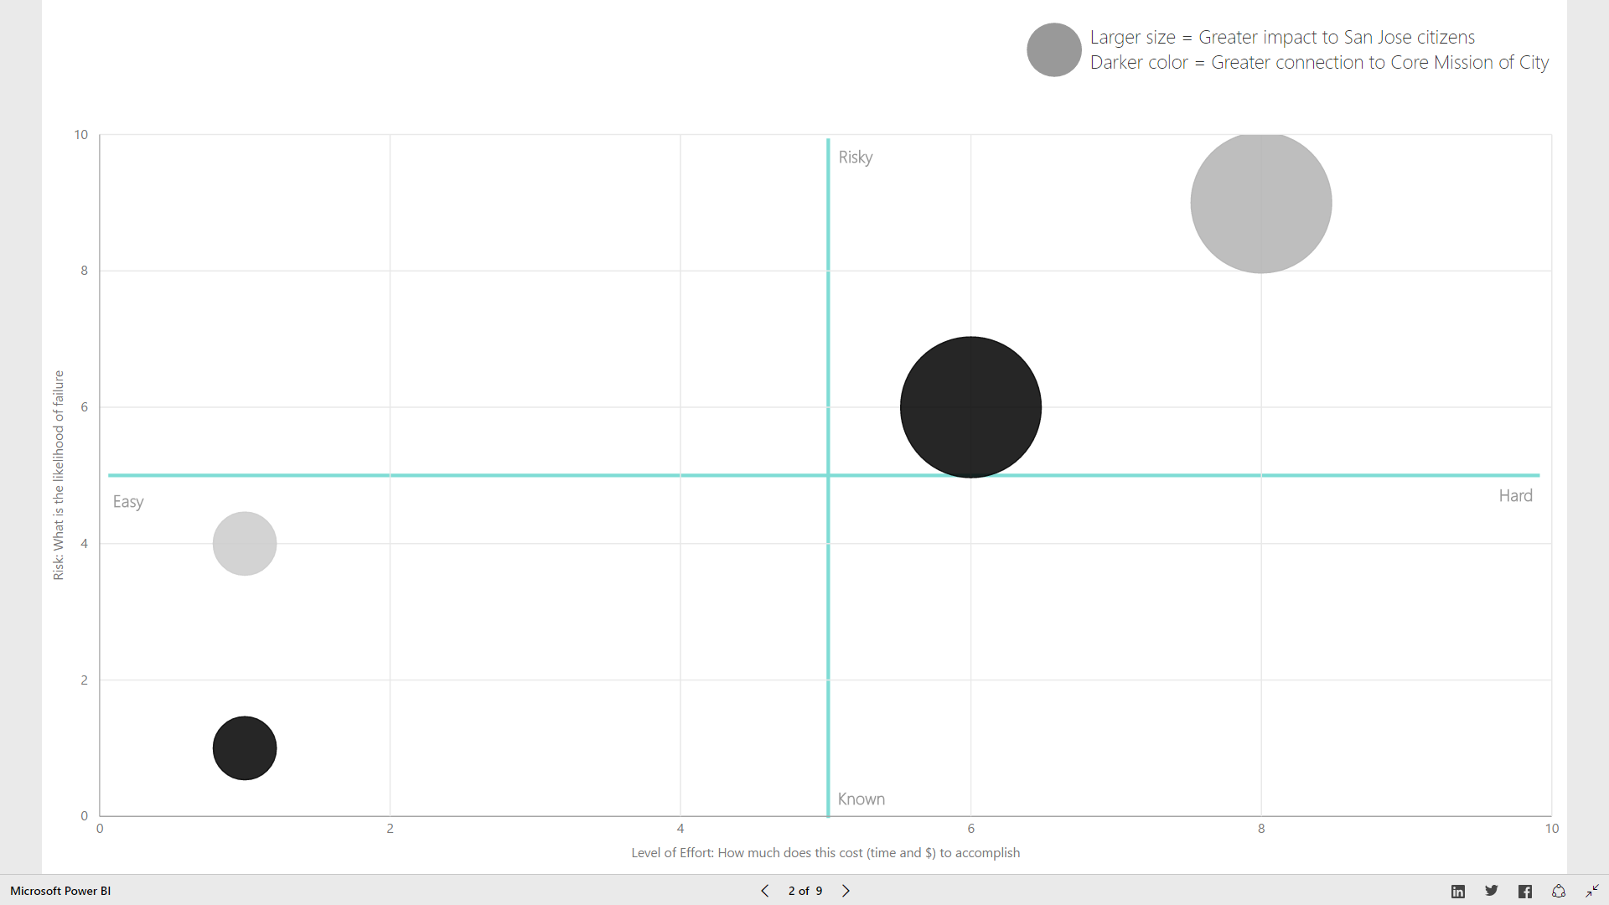
Impact
Core

Slide 16
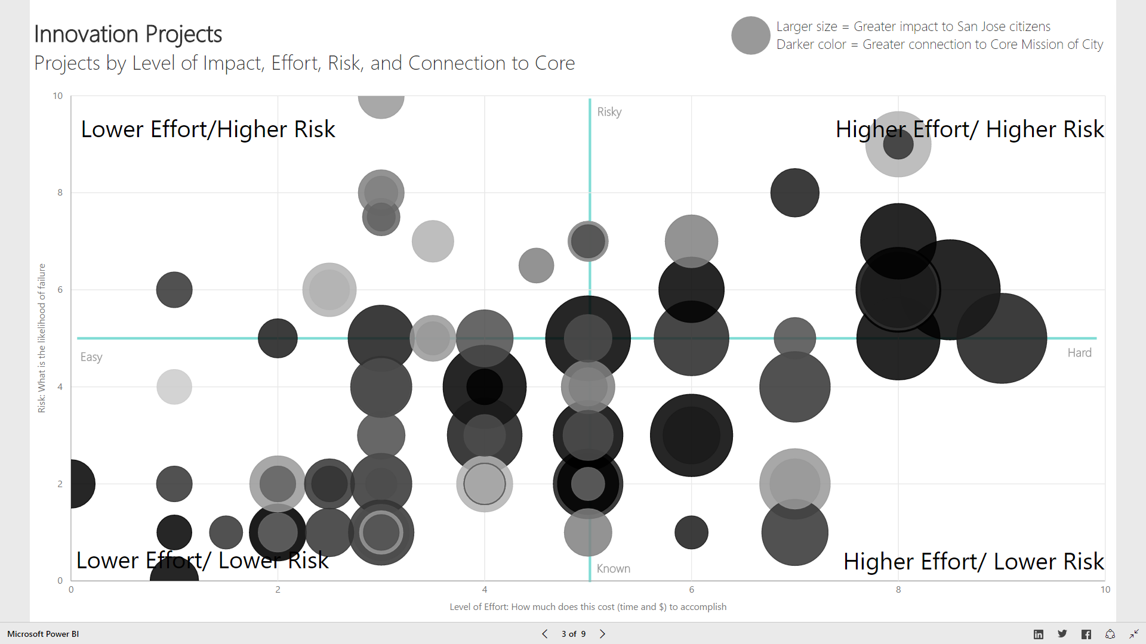

Slide 17
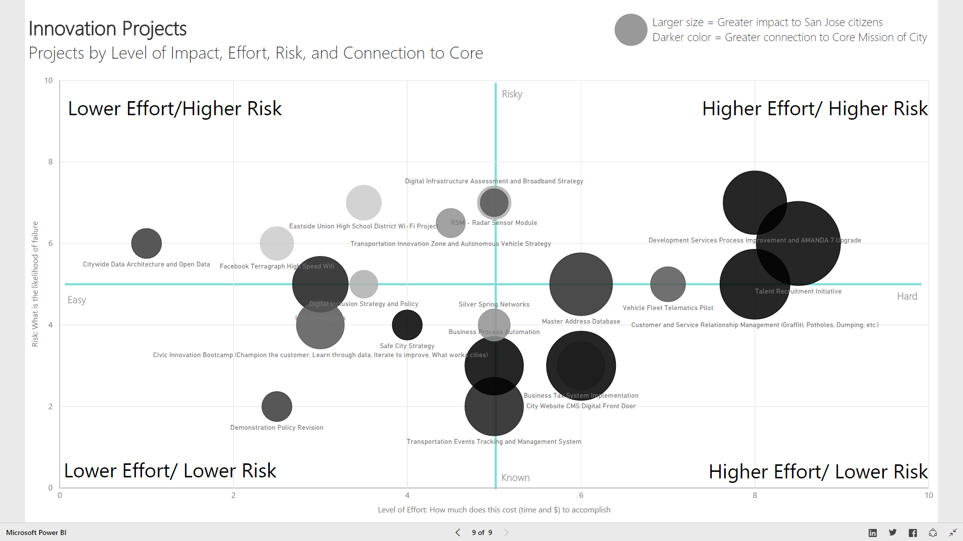

Slide 18
HOW should we do our work?
Notes:
“Why are we here?” Activity Discussion
Goal: Ground the event in participants’ own motivations and interests in innovation.
Supplies: 2 wireless mics, pens, post-it notes
Instructions for the group:
Why does innovation matter? “Think about the last 12 months in the City of San Jose, come up with one example of EITHER something really innovative that it inspired you, or something so painful that you wanted to change it immediately. We’ll give you a few minutes to reflect and think of a one story. (2 minutes)
“Now, turn to your neighbor and exchange stories.” (4 minutes each, 8 minutes total)
“Who heard a story that they’d like to share with the group?” (Share stories from a few people – 8 minutes)

Slide 19
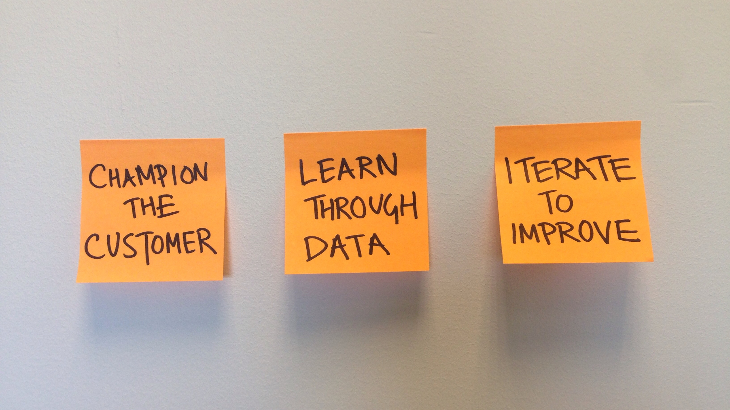
How we approach our work
Notes:
How we do this work is as important as what we work on.
Taking a page from methods that have been proven in the Silicon Valley and elsewhere, here are the three core principles of how we work.
Champion the customer: Relentlessly focus on the user experience, by integrating human centered design principles into service delivery and technology platforms.
Learn through Data –Track our progress using data to generate patterns, develop insights and translate insights into actions.
Iterate to Improve- We prototype new services or processes and then iterate multiple times to learn and refine our offerings.
When applied, these principles keep us focused on the public we’re trying to serve, keep us accountable through tracking our progress, and form a virtuous cycle of continuous improvement.
Here are a few examples of these principles in action.

Slide 20

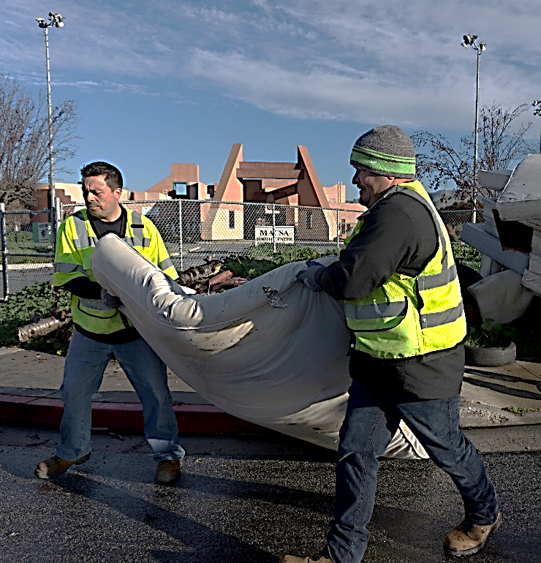
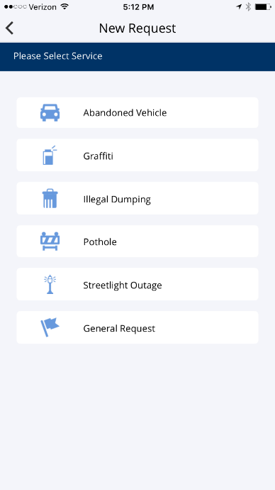
Champion the customer
Customer-Facing App
Citywide CRM
Platform
Department Work Order Systems
Auto-routing
DOT
PRNS
Call Center
ESD
Real-time two-way communication
Notes:
Here in San Jose, we’re also working on creating a seamless customer experience to serve our residents better. Our new customer relationship management platform will soft launch before the end of this month. What residents will see is an app, which they can access on their phones, or on the web, to report potholes, graffiti, illegal dumping, abandoned vehicles and streetlight outages – five of the most requested items from our contact center.
The big change in their experience is that their requests will go directly to the departmental work order systems, and they will receive notifications as their request are resolved.
Chris Mills, Swati Ganesh and their team accomplished this through a few key principles:
- Collaborating across City departments, with weekly “conference room pilots” to demonstrate developing features and identify issues early
- Testing early and often with real users
- Refining based on feedback from users

Slide 21
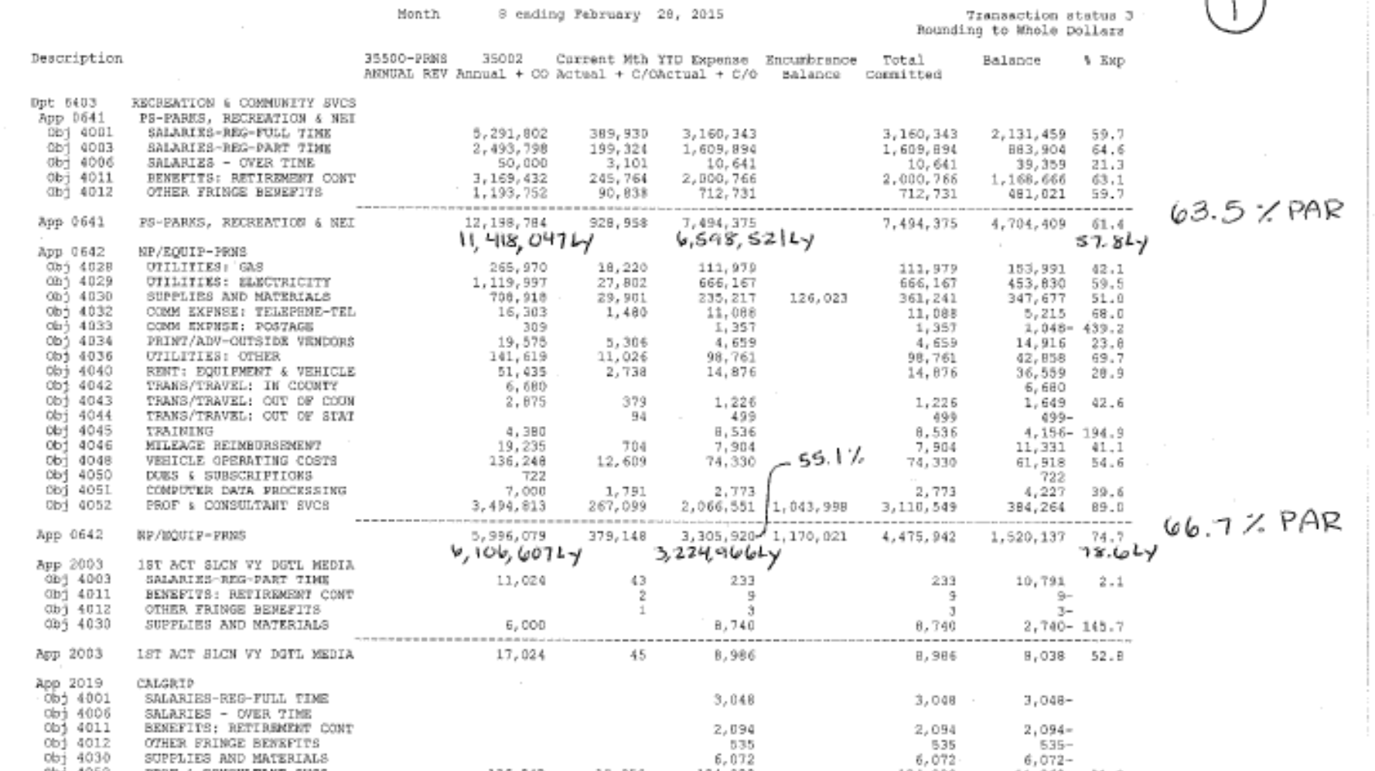
Learn through data
Notes:
[Turn it over to Avi Yotam, PRNS Administrative Services Division Manager]
This is a story about how our team is innovating how we learn from our financial data.
In such a decentralized department, our administrative team needs to work closely with numerous different program staff to manage budgets. What’s not great is how we shared information.
Up until early 2015, we used standard FMS reports to share budget and spending status. As you can see on the screen, these reports don’t show the trend, comparative analysis, or information on cost recovery.
We needed to use the data in a better way so we could see spending patterns, generate insights, and make better decisions.

Slide 22
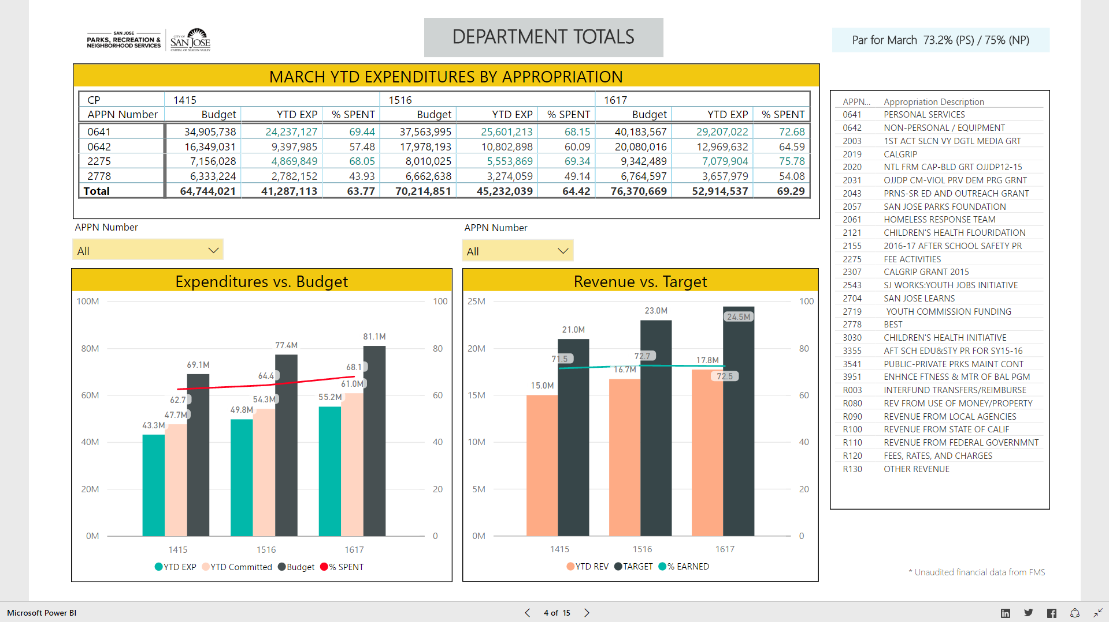
Learn through data
Notes:
Included in case the video on previous slide doesn’t work.

Slide 23
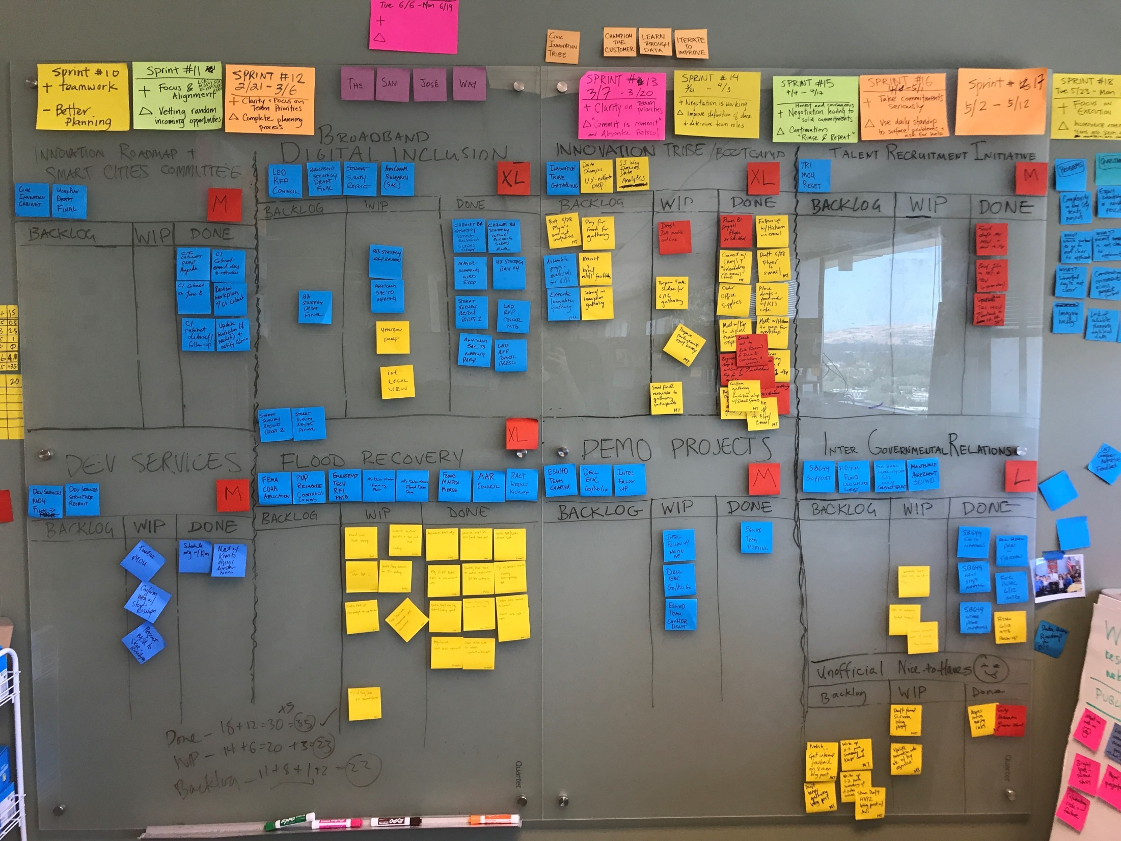
Iterate to improve
Notes:
So, 9 months ago, our team decided to adopt a framework called scrum. Scrum is a tool that’s been really helpful in managing our work. It’s lightweight, doesn’t require software and is adaptable to whatever your projects might be. The goal is to manage your project deliverables in 1-2 week chunks or sprints as we call them. Your supervisor and team plan out at the beginning of the 2 week sprint what the team can commit to given the limitations of time and team bandwidth. Then it’s up to the team to break these deliverables down into discrete tasks. The point is to clear the scrum board so all tasks move from backlog to done. After each sprint we reflect on what went well and what we want to change for the next sprint. Its these iterations that have helped us refine our process and continuously improve.

Slide 24
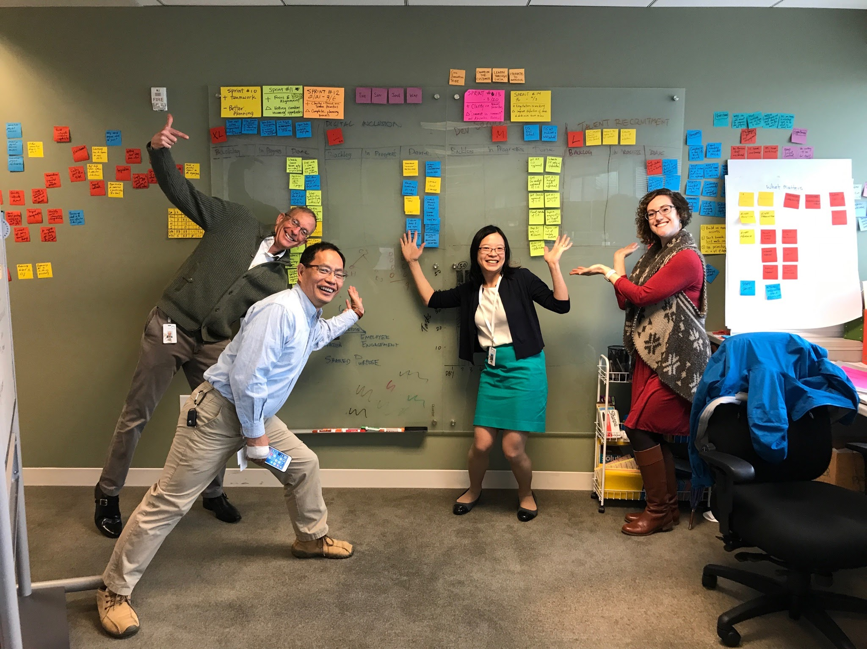
Iterate to improve
Notes:
What you’re seeing on the Stickies Michelle is putting on the wall is 9 months worth of iteration over 19 sprints. We haven’t quite come close to Edison’s 1000 iterations, but each time we reflect on the sprint, we learn something new to try. For example, in sprint 11 we loved how focused and aligned we felt as a team, but we still needed to work on vetting random incoming opportunities that seemed to crop up mid-sprint
. It wasn’t perfect to begin with, and it was frustrating and there were a lot of kinks to work out. Iteration helped us see that we were making progress, and reflecting on these iterations helped us to refine the scrum process and it’s ability to help reach our team objectives.. It takes discipline and the results are a highly effective team with everyone focused on a common goal.
If you are interested in adopting scrum for your team, our office is working on a training program that will be rolled out in late July. We’ll share more information on that when it becomes available.

Slide 25
2017 Framework for Innovation | Strategy Vision | Traditional Government Customer Experience | Paper and In-Person Often Still Frustrating Gaining Empathy
 |  | Exploring Process | Many to Vital Few Innovation Roadmap Smart Cities Vision
 |  | Updating Technology | Brilliant at the Basics Replatforming Investing in Security
 |  | Engaging People | Gathering Tribe Office of Civic Innovation CIO External Partners in Silicon Valley
Notes:
Office 365

Slide 27
Innovation Roadmap Projects
PRODUCT LINES
PROCESS IMPROVEMENT | Talent Recruitment Initiative | Development Services
DIGITAL FRONT DOOR | My San Jose | Website Upgrade
SMART CITY INFRASTRUCTURE | Broadband & Digital Inclusion | LED streetlights/ anyCOMM pilot | IoT Strategy
DEMO PROJECTS | Facebook Terragraph WiFi | Eastside Union HSD WiFI | Silver Spring Networks | Demonstration Policy
IT BRILLIANT AT THE BASICS | Open Data Architecture | Business Process Automation | Business Tax System | Integrated Permitting System
TRANSPORTATION | Autonomous Vehicle RFI | Transportation Events Tracking | Radar Sensor Module Strategy | Vehicle Fleet Telematics
SAFE CITY | Safe City Strategy | Emergency Mgmt Tech/Data
INNOVATION SUPPORT | Innovation Bootcamp
PRIORITIZATION
Non-Negotiable Citywide Implementation | Highly Desirable Strategic Investments | Desirable Dept Investments | Demonstration Projects | Emerging Projects

Slide 28
2020 Innovation in Action As innovative as the community we serve | Strategy Roadmap | Delightful Customer Experience | Easy Responsive Digital Mobile
 |  | Agile Process | Champion the Customer Learn from Data Iterate to Improve
 |  | Enabling Technology | Modern Platform Data Architecture/Open APIs Secure Resilient Systems
 |  | Engaged People | Empowered to Take Action Digitally Fluent Network of Partners

Slide 29
Innovation Roadmap Projects
PRODUCT LINES
PROCESS IMPROVEMENT | Talent Recruitment Initiative | Development Services
DIGITAL FRONT DOOR | My San Jose | Website Upgrade
SMART CITY INFRASTRUCTURE | Broadband & Digital Inclusion | LED streetlights/ anyCOMM pilot | IoT Strategy
DEMO PROJECTS | Facebook Terragraph WiFi | Eastside Union HSD WiFI | Silver Spring Networks | Demonstration Policy
IT BRILLIANT AT THE BASICS | Open Data Architecture | Business Process Automation | Business Tax System | Integrated Permitting System
TRANSPORTATION | Autonomous Vehicle RFI | Transportation Events Tracking | Radar Sensor Module Strategy | Vehicle Fleet Telematics
SAFE CITY | Safe City Strategy | Emergency Mgmt Tech/Data
INNOVATION SUPPORT | Innovation Bootcamp
45% | No unmanageable issues
23% | Minor issues
9% | Significant issues
14% | Major issues, at risk

Slide 30
Broadband Strategy Current State – Broadband Summary
Source: Akamai and speedtest.net
San Jose’s broadband significantly lags our peers

Slide 31
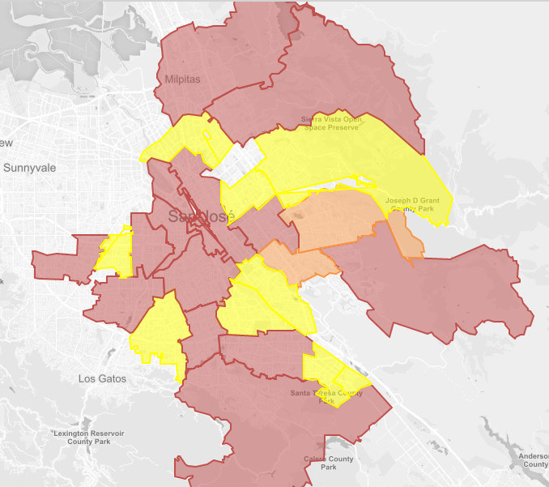
Broadband Strategy Current State – Broadband Summary
High-quality fiber access confined to 2.7% of the City’s census tracts
Slow mobile and wireline access is widespread
City is not strongly influencing the market
Fiber build-out vs. median income
User-reported mobile download speeds
Wireline residential fiber access as of mid-2016
Absence
Presence
Area of high median income
0 - 9 mbps
10 - 19 mbps
20 - 49 mbps
Source: FCC 477 including residential and commercial broadband
Without City engagement this market dynamic will not change

Slide 32
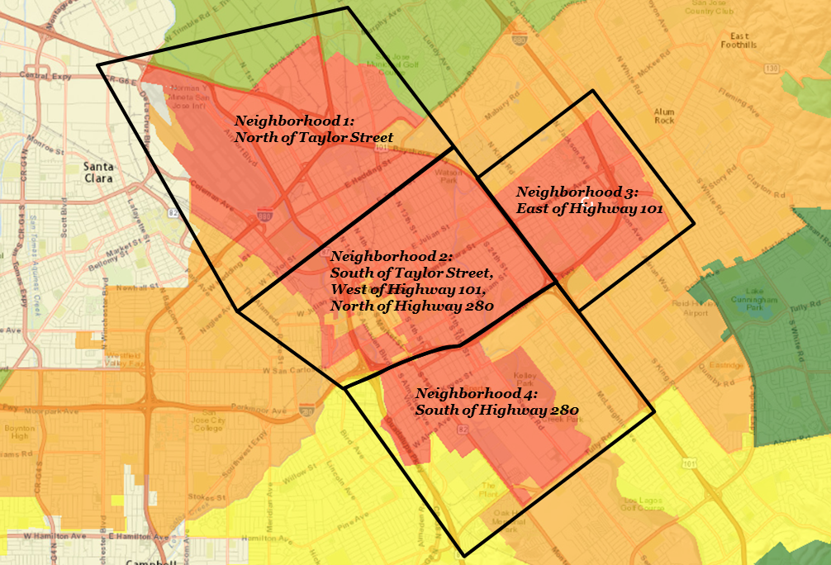
Broadband Strategy Current state: Digital Inclusion
This analysis examined the digitally-excluded areas of the City by zooming in on “hotspots” of digitally-excluded residents
Our analysis generated four zoomed-in neighborhoods, as seen at left
The area of focus of ESUHSD is indeed a “high” priority area and nearby areas are candidates for free community Wi-FI
Several City buildings (libraries, community centers) exist in these areas that could anchor City interventions
ESUHSD Community Wi-Fi
San Jose’s primary digitally excluded (~10%) is low income Latinos with high school degrees or less living near downtown

Slide 33
Summary – ‘No Regrets’ Recommendations
Being the US innovation leader will require many actions, but one non-negotiable element is the ability of all San Jose’s citizens and businesses to connect to the highest-quality broadband network available while providing equity and inclusion for the under resourced.
Staffing and Leadership | Policy/Standards | Governance
Consolidated broadband governance and execution Dedicated team singularly focused on pole attachments and the permitting process Digital inclusion collective impact organization leadership and capacity building | Dig once policy Micro trenching and nano trenching standards Pole attachment streamlining and standards Power interconnection policy Attachment rate policy including network/large batch pricing Privacy policy Security policy Digital inclusion priority policy | Master Lease Agreement (consider)
Programs and Projects |  | Infrastructure
Digital Inclusion Awareness Events Public Wi-Fi (opportunistic) Device donation and/or refurbishment pilot Device leasing pilot Family digital literacy program expansion Seniors digital inclusion program expansion |  | Targeted at medium term

Slide 34
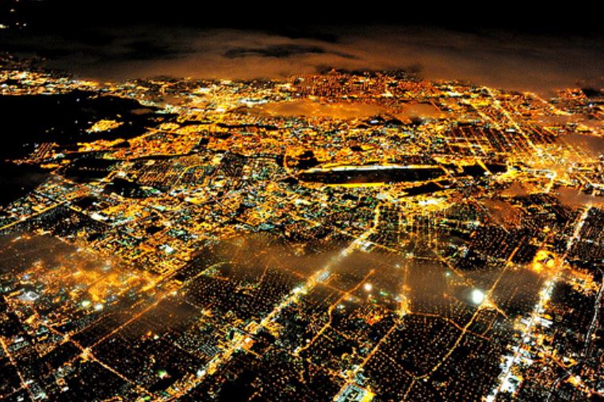
It all starts with street lights….
Notes:
Introduction – Dave Sykes
Where we started: a few years ago, private sector companies telling us that they could convert our streetlights for free:
Front the money, pay the conversion costs through energy savings OR
Convert the streetlight in exchange for access to our right-of-way (SmartPoles)
These unsolicited proposals were interesting, however, under our procurement rules, the City needed to conduct some sort of procurement. So in 2015, Council directed staff to issue the RFP before you today.
When the responses came back, they were intriguing. However, none of them met the original goal of converting streetlights at little to no cost to the General Fund. Each proposal had promising components, and the staff team worked hard to thoroughly vet, understand, review, and score the proposals. Staff did so because we how much you and our residents want LED streetlights. The team has worked diligently to find a path forward with this RFP.

Slide 35
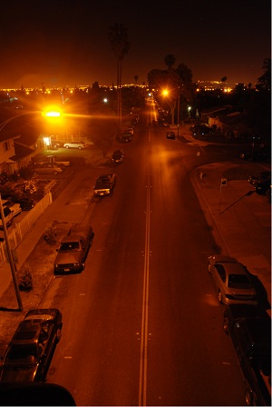
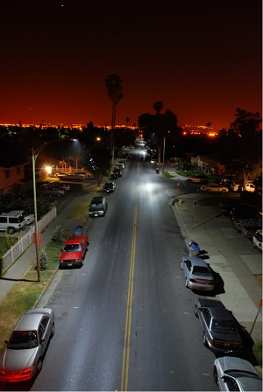
Why LEDs?
Before
After
Sodium Vapor Streetlights
LED Streetlights
Notes:
Kevin O’Connor
As Dave said, this RFP was about streetlights.
64,400 active streetlights
1970s: Energy Crisis. Sodium vapor lights installed.
10 years ago, San José partnered with the lighting industry to bring LED streetlights to market. We conducted tests in our neighborhoods and worked with Lick Observatory to minimize impacts through design and dimming.
Results: LED Streetlights:
Improved Visibility
Use less energy
Last longer 15-20 years vs. 5-7
Don’t put toxics into the landfill
Can be dimmed (with controller unit)
However: LEDs cost more than existing lights
Can’t change bulbs; must replace luminaire
2007: Green Vision adopted
2008-2015: 25,000 LED streetlights with controller units
7,000 grants/one-time funds
18,000 ESCO

Slide 36
Energy Savings: San José vs. Other Cities
 | Most Common Lamps | Energy Consumption (watts) | LED Replacement (watts) | Wattage Reduction | % Energy Savings
San José | 55W LPS | 85 | 35 | 50 | 59%
 | 135W LPS | 181 | 79 | 102 | 56%
Others | 100W HPS | 138 | 34 | 104 | 75%
 | 150W HPS | 202 | 56 | 146 | 72%
Notes:
Kevin O’Connor
Questions staff gets asked: Why are neighboring cities able to convert their streetlights more quickly than San José? Why is it so difficult here?
San José’s lights are already fairly energy efficient.
Most Cities have High Pressure sodium lights. San José has low pressure sodium lights. This chart shows the difference in energy savings.
A city with High Pressure Sodium lights would recoup their upfront costs through energy savings in about 7 years, while in San José the energy savings would take about 15 years to pay off.
In addition, most cities use simple photo cells to turn lights on & off. Our Council Policy calls for our LED lights to be dimmable. The controller units add about $6 million to the cost of converting the remaining lights. The dimming costs do not pay for themselves over time.

Slide 37
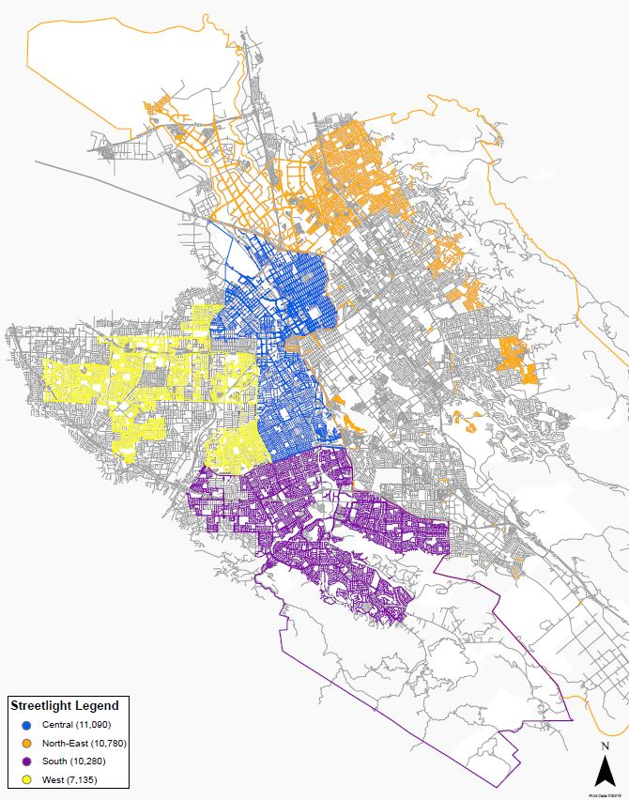
The RFP
What we asked for:
Convert our streetlights to LED with smart controllers at low or no cost.
What we got:
Convert your streetlights to LED at normal cost and get the smart controllers and a start up IoT sensor platform at no cost…
Notes:
RFP Overview – Michelle McGurk
2013-2015: Unsolicited proposals
2015: Philips, anyCOMM demonstration partnership agreements
(In the Philips demonstration project, the company converted 750 lights in exchange for the ability to install and test 50 SmartPoles on City sidewalks)
(anyCOMM was in contract to install and test 166 units, however only 8 were installed and the demonstration project concluded without any
Council directed staff to go out to RFP Innovative LED Replacement RFP
Allow proposers to use City real estate assets in exchange for converting lights. These could include real estate, small-cell telecom, naming rights. Accepted Installation proposals and In-Lieu Proposals (where City obtains cash that could be used to convert streetlights)
Never done anything like this in San José Options were wide open.
11 proposals in phase 1; 6 proposals in phase 2. 4 Finalists.

Slide 38
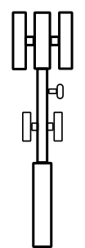





Existing landscape for VOICE and data
Little change in over 20 years
Cell towers: carry all mobile voice & data
Slower Speed
Copper Lines
Notes:
KIP Harkness
Good Afternoon, Honorable Mayor, Members of the Council, and the Public. Kip Harkness, Deputy City Manager with the portfolio of Civic Innovation and Digital Strategy.
I want step back and take us through a little bit of a primer on some of the technology ecosystems that are important for us to understand as we make decisions to build out our smart City, and then walk though the staff recommendation to reject all bids and separate out the procurement of LED lighting form the IoT procurement.
Lets start with existing landscape designed to carry voice and secondarily data. This is the morphology (architecture) we have had for several decades – a voice focused architecture which supported the evolution from 1G to 2G to 3G to our current state of 4G/LTE. It is characterized by copper wire going to the premise supported by Marco cell towers to carry all Mobile voice and data commination. This network can provide effective voice communication in home and mobile but slower than we now expect for in home data and mobile.

Slide 39
Emerging landscape for voice and DATA
Effective in Dense Urban, Urban, and Suburban
Cell towers: carry all mobile voice & some data
Small-Cells
Gigabit speed
up to 50x faster
Fiber Lines
Notes:
Kip Harkness
TRENDS: Over the last two decades, and especially in the last 5-7 years we have seen an explosive growth of Mobile, Data Usage, and Customer Expectations.
All of these have combined to create a high and to the right demand by customers for faster speed access everywhere. Just think about your own usage pattern as an example 10 years ago we were fine with a half way decent voice call and some texting… now we expect to be able to stream movies while our phones map our location and pay for our purchase all without missing a beat.
Above is the morphology (architecture) that is emerging to support better 4G/LTE and the next evolution – 5G or 5th generation mobile networks which is the proposed next major phase of mobile telecommunications standards beyond the current 4G/LTE standards.
This morphology is characterized by fiber optic cable which take advantage of the fastest thing in the universe light, you also see the emergence of small cells connected to fiber to provide higher speed mobile coverage than is possible with just macro-towers alone. Though we expect those macro towers to remain an important component. You also see in building solutions as significant part of the morphology.
The standards body defining 5G (The 3GPP or the Third Generation Partnership Project) is expecting initial standards to be finalized first quarter next year – 6 months ahead of schedule - and you are already seeing 5G pilots by AT&T and Verizon and other service providers.
This landscape provides for dramatically increased speeds to meet our mobile data needs and is particularly well suited to Dense Urban, Urban, and Suburban landscapes which is covers almost all of San Jose.

Slide 40

Early considerations on street light pole
STREETLIGHT
SMALL CELLs
INTERNET OF THINGS
Light/Safety
Broadband Digital Infrastructure
Smart Cities
Properties
Height
Power
Light Sensor
Lumens
Density
Properties
Height
Power
Light Sensor
Lumens
Density
Data Backhaul (Fiber, COAX, Radio mesh)
Properties
Height
Power
Light Sensor
Lumens
Density
Data Backhaul
Sensors
Cameras
2-way Communication
Banner Advertising
Maturity:
Mature
Emerging
Extremely Immature
Possible Action:
Proceed w/ LED Light Replacement Only
Re-examine in Broadband Strategy
Seek to Understand with Knight IoT Grant
Notes:
Kip Harkness
What this emerging 5G landscape does is radically change both the function and value of our public street lights.
For hundreds years since the first public street light poles were installed in Paris under Louis XIV we have thought of thought of public street light poles as poles that provide light to the public on the street. Important but pretty straight forward.
As we worked with PwC in recent months developing the City’s first ever Broadband strategy we realized that with the mobile & data imperative, and resulting shift in the morphology to support 5G that we described earlier AND the parallel emergence of the Internet of Things (IoT) as a primary tool for the Smart City, That public street light poles are now a key component in the information infrastructure of the 21rst centruty and are the city’s most important point of leverage as we support the build out of broadband and the development of a smart city with a robust IoT network.
Bottom Line: There is increasing value to our street light poles and we need be thoughtful and intentional in how we trade that value for our future.
We now think about our poles has having a role in three technological swim lanes that are at significantly different states of maturity.
STREET LIGHT :The first swim lane is Streetlights where LEDs represent the dominant mature technology. This was the starting point of the RFP and the core goal, to convert our remaining low-pressure sodium lights to more energy efficient, white, light, and controllable LEDs. Again I think it is worth mentioning that this technology is now mature in part because of years of experimentation with our DOT and various LED pioneers. We understand this technology well, and our cities requirements. We feel we are ready to move forward in this area quickly.
SMALL CELLS: The second swim lane is for small cells to power the 5G deployment, this swim lane uses our poles to provide three things access (thing unobstructed height), power, and access through data through backhaul typically to fiber. We have been actively involved in this swim lane and have established a council approved leasing policy that sets appropriate prices for access to poles and provides a ministerial permitting process to speed approvals. There is a great deal of potential change in this swim lane as new State laws and Federal regulations are under consideration that would dramatically reduce local control and our city’s ability to capture the full value of our public infrastructure. We feel that we should re-examine our policies and permitting procedures in this area in light of the developing broadband strategy to promote fast and equitable broadband deployment.
INTERNET of THINGS: The third swim lane is the Internet of things for smart cities which includes the use of a range of sensors including lighting control, cameras, and many other uses. This swim lane is the most immature of the three. To quote Telensa, a global leader in the field “The smart city IoT market is awash with pilot applications looking for a business case, Low Power Wide Area wireless networks waiting for a critical mass of devices, and vendors hoping for a path to profit.” Because of this immaturity we recommend taking advantage of a $200k Knight grant we recently received to do a rapid deep dive into IoT to seek to understand a San Jose approach to the technology space and initial requirements before moving to procurement at scale.
Before we move away from poles I want to briefly explore the question of exclusive v. non-exclusive access to our poles. The top ranked proposer is offering non-exclusive access to our poles for other providers, and I believe they are doing so in good faith, but the reality is more complex, and because of three powerful drivers we may end up awarding de facto exclusive access to our poles.
The drivers are
1) fist mover advantage which means whoever is first up on the poles will take the prime poles, the best locations on those poles and use up much of the incremental electricity and structural strength. Meaning that other providers might have to do significant upgrades to the pole for structural and electrical reasons and still be locked out of the best access point.
2) Technical – which includes potential interference with equipment already on the pole, the need for increased coordination in installation, operation and maintenance.
3) Business – which include a the fact that providers are usually direct competitors or base their business model on leasing their space to others, not having additional competitive cells mounted near them. All of which amounts to a substantial disincentive to coordination.
All three of these drivers combined mean that while poles may be non-exclusive, they could in many cases become de-facto exclusive. As an added data point we know of no small cell deployment in the united states where competing carriers have mounted small cells on the same conventional pole. NYC is currently beginning a pilot to explore if this can work in the real world.

Slide 41
Notes:
Dave Sykes
When we initially came forward in January, our working premise was that
None of the installation proposals was exclusive. If another player wanted to hang equipment or devices on the poles, that would be possible.
While the revenue picture wasn’t completely clear with some of the proposals, the City wasn’t going to lose money that we might make from other players, because the exclusivity wasn’t there.
This was about streetlights. We didn’t go looking to change or create policies, and we weren’t looking to put cameras or sensors on streetlights. We still have a lot of policy work to do around data collection and use, and privacy. We also have a lot of work to do around outdoor advertising and electronic billboards.
Since January, our original premise has been eroding. While our first recommendation was lukewarm at best, we are now recommending that you reject all proposals. Staff believes that by going back to a traditional procurement model we can install the streetlights, potentially at a lower cost. We can get our broadband and Internet of Things policies in place. We can work with industry to pilot the next-generation controller units.
I am proud of the work staff has done with this RFP. You directed us to try something innovative, to go broad and see how the market would respond. With innovation comes risk, as many of our Valley’s great innovators often say. Frequently, those risks don’t pan out, but in the process something critical is learned. That is true with this RFP. While the outcome did not meet the original goals, staff has learned a great deal through the process

Slide 42
IoT Smart City Reference Architecture
Smart City Applications
Enables city government, private sector and citizens to leverage data and analytics to improve services (e.g., Control Center for lighting, Tourism Apps, etc.).
Layer 1:
Smart Applications
City Operating System (City OS)
Enables the data aggregation, analysis, modeling and predictive analysis
Data
City Open Data, Social Media Data, etc.
Layer 2:
OS and Data Layer
Security
Layer 3A:
Sensor Data Platform
Privacy
Sensor Platform
Enables the integration of both proprietary and open source sensors data
Layer 3B:
Sensors
Lighting Sensors
Irrigation Sensors
Parking Sensors
Waste Sensors
Traffic Sensors
Weather Sensors
Other Sensors
Fixed and Wireless Broadband Infrastructure
City-wide fiber optic and wireless networks, enables data aggregation and system control
Layer 4:
Network Infrastructure
Fiber
COAX
Small Cells
Wi-Fi
5G
3G, 4G
Other Machine to
Machine
Source: Consultant analysis, Barcelona city government website, Cisco.
Notes:
KIP
So let’s take a moment to think together through a Smart Cities and IoT architecture. A successful smart city approach requires a comprehensive architecture such as the one here modeled after Barcelona which has one of the most developed IoT systems globally.
This includes… Go layer by layer 4, 3B, 3A, 2, 1
And along side these layers a City should have robust and practical policies and architecture for both protection of Individual Privacy and the comprehensive Security of devices, the network, the platform and the data… with out these twin guard rails we put at risk the privacy of our residents and the functionality of our smart city.
In addition, above all this, Layer 0 if you will, are the real world use cases and problems we are trying to solve that should drive the architecture of the layers below it. Not the other way around.
With the AnyComm proposal we get a get aspects of layers 3 and 4 with a clear use case of lighting control. We do not get a architecture that is based on our requirements, that integrates with our existing sensor network, or has the privacy guarantees that we desire.
As an innovator I’ll be the first to say that the proposed AnyCOMM deployment is a fascinating one that I would love to be playing with and learning from today.
As a Civic Innovator I want to make sure that any technology we procure is addressing real world problems and provides an architecture, including privacy and integration with existing sensors that meets our needs and requirements. The truth is our thinking on Smart Cities and IoT is still emerging and we need a little more time before we can say what we are looking for.
As a Deputy City Manager I want to make sure we are getting the best deal for the city and that we have had a chance to see what the other options that other firms and companies might propose. In this regard it is important to remember we did an RFP for streetlight conversion, not IoT smart cities and so have not seen what competing firms such as Telensa, Dell EMC, NTT, GE, AT&T as well as local powerhouses such as Cisco, Intel, Silver Spring Networks and even Facebook, as well as the hundreds of startups in this space that are every day reaching out to us seeking to be part of an IoT smart cities solution in San Jose.
Bottom Line: We haven’t put out our IoT requirements to the marketplace, and literally do not know what we are missing.
Consider using the kitchen remodel analogy here.
Key points:
We haven’t defined smart applications beyond traffic applications within our DOT-centric architecture
We don’t have an operating system or data layer requirements specified or sourced
We don’t have a sensor data aggregation platform requirements specified or sourced
We are considering making a major decision in the sensors themselves without understanding with what and how they communicate
We are considering a major decision about municipal broadband infrastructure without having requirements specified or sourced
Examples of what Cities have selected in this space:
San Diego recently announced the selection of General Electric’s Current Platform (for LED street lights and controllers), ShotSpotter Gunshot Senors, CivicSmart on street parking locator, and AT&T LTE network for the underlying IoT networking.
Atlanta, London, and Shanghai are all working with Telensa who has 50 large scale smart city lighting and networks commercially deployed.
There is a lot of energy in this space with many options available to San Jose that we have not evaluated. For example, what is the best wireless technology for M2M – Wi-Fi? Sigfox? LoRa recently adopted by Comcast? Narrowband IoT and LTE-M being pursued by the service providers?

Slide 43
Questions? Kip Harkness @kipthinks kip.harkness@sanjoseca.gov
Office of Civic Innovation and Digital Strategy
Kip Harkness | Dolan Beckel | Erica Garaffo | Michelle Thong

